Slide 1
Application of Quasi-Newton Algorithms in Optimal Design
Sebastian Ueckert, Joakim Nyberg, Andrew C. Hooker
Pharmacometrics Research Group
Department of Pharmaceutical Biosciences
Uppsala University
Sweden

Slide 2
Outline
Optimizing Designs
Introduction: Quasi-Newton Methods (QNMs)
Performance QNMs
Advantages QNMs
Laplace Approximation for Global Optimal Design
Using QNMs in Laplace Approximation

Slide 3
Optimizing a Design
Model
Parameters α
Design variables x
Data
Estimation
e.g. D-Optimal Design

Slide 4
Optimization
Interval methods
True global optimizers
Hard to implement
Still under development
Stochastic methods
Simulated Annealing (SA), Ant colony optimization, Genetic Algorithm(GA)
Easy to implement (SA)
Marketing effective (GA)
Slow
No information about solution
Heuristic

Slide 5
Optimization
Derivative free methods
Downhill Simplex Method
No derivatives necessary
Robust
Slow
Local

Slide 6
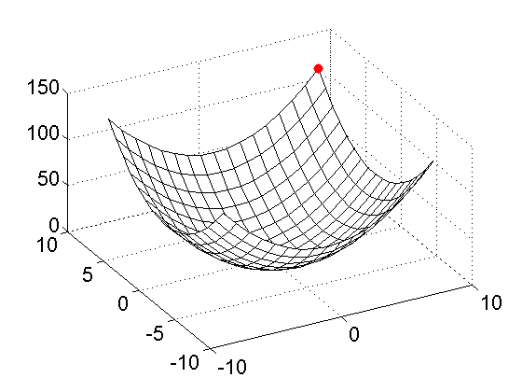
Gradient Based Methods

Slide 7
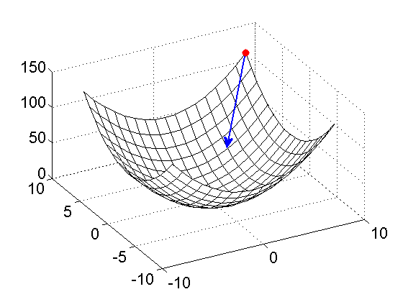
Gradient Based Methods

Slide 8
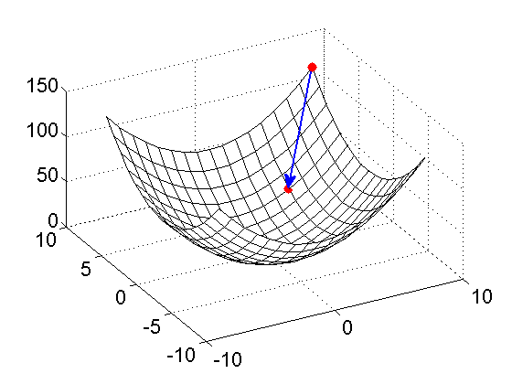
Gradient Based Methods

Slide 9
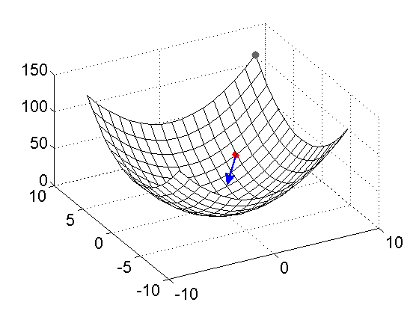
Gradient Based Methods

Slide 10
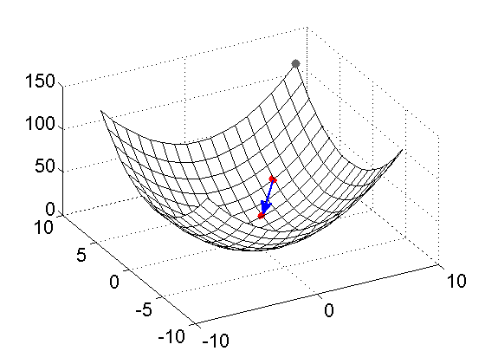
Gradient Based Methods

Slide 11
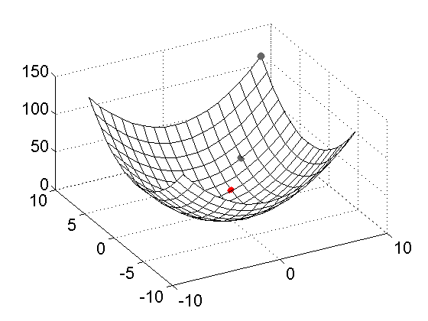
Gradient Based Methods

Slide 12
Gradient Based Methods
Mathematically well understood
Fast (if OFV calc not too expensive)
Only local
Complicated to implement
Steepest Descent
Conjugate Gradient

Slide 13
Newton Method
Goal:
Algorithm:
Set x_{k}=x₀
Determine search direction
Do line search along p* to find minimal x_{k+1}
Set x_{k}=x_{k+1} and go to 2

Slide 14
Newton Method
Goal:
Algorithm:
Set x_{k}=x₀
Determine search direction
Do line search along p* to find minimal x_{k+1}
Set x_{k}=x_{k+1} and go to 2
Calculate Hessian

Slide 15
Quasi-Newton Methods
Problem:
Calculation of Hessian is computationally expensive
Approach:
Use approx. Hessian and build up during search
Algorithm:
Set x_{k}=x₀, B_{k}=I
Determine search direction
Do line search along p* to find minimal x_{k+1}
Set x_{k}=x_{k+1}, B_{k}=B_{k}+U_{k} and go to 2

Slide 16
Quasi-Newton Methods
Different methods for different updating formulas
Davidon–Fletcher–Powell (DFP)
Broyden-Fletcher-Goldfarb-Shanno (BFGS)

Slide 17
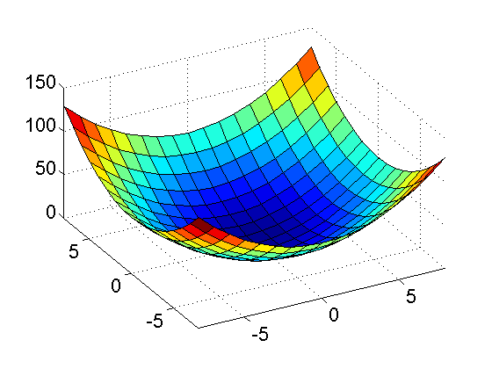
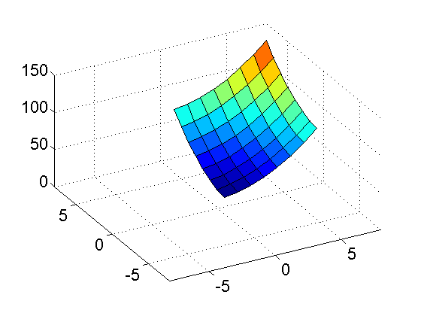
Constraints
Experiments usually come with practicality constraints e.g.:
Administered dose has to be smaller than X mg
Sampling times can only be taken until 8 h after dosing
➔Box Constraints
BFGS-B

Slide 18
BFGS-B
Algorithm:
Set x_{k}=x₀, B_{k}=I
Determine search direction
Project search direction vector on feasible region
Do line search along p* to find minimal x_{k+1} respecting bounds
Set x_{k}=x_{k+1}, B_{k}=B_{k}+U_{k} and go to 2

Slide 19
Comparison
Test Scenario
Model:
PKPD (1 cmp oral absorption; IMAX drug effect)
All parameters (ka,CL,V,IC50, E0, IMAX) with log-normal IIV 30% CV
PK parameters fixed
Combined error
Design:
3 groups (40,30,30 subjects)
1 PK and 1 PD sample per subject
Approach:
Generate random initial values
Optimize with steepest descent and BFGS

Slide 20
Results
Frequency[%]
Runtime [s]
OFV
 | Steepest Descent
 | BFGS

Slide 21
Design Sensitivity
Approximate Hessian matrix can be used to assess sensitivity of design (at no additional computational costs)
Diagonal of the inverse of the Hessian
Use approximate efficiency

Slide 22
Design Sensitivity - Visual
Group 2 PD
Group 1 PK
Group 1 PD

Slide 23
Design Sensitivity - Numerical
 | PK Sample |  | PD Sample
Group 1 | 7.12 | [0.35;13.9] | 8.38 | [5.28;11.38]
Group 2 | 1.26 | [0;3.74] | 1.79 | [1.03;2.55]
Group 3 | 9.22 | [-1.31E;+1.31E] | 0 | [0;0.0025]
Group 1 PK
Group 3 PK
Group 2 PD

Slide 24
Laplace Approximation

Slide 25
Global Optimal Design
Integral has to be evaluated
FIM occurs in integrand
For example ED optimal design:
Usually evaluated with Monte-Carlo integration
→Computationally intensive or imprecise

Slide 26
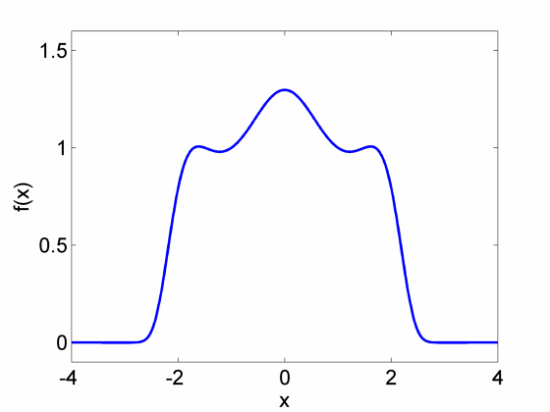
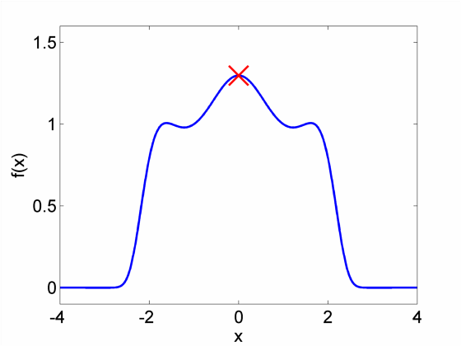
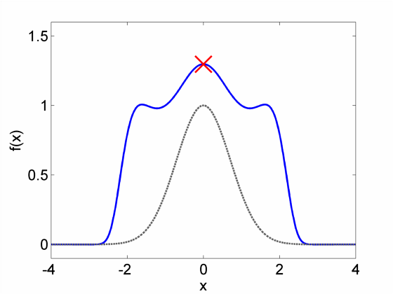
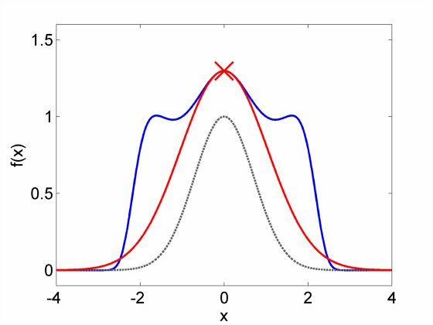
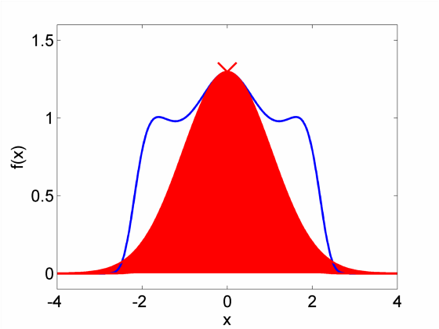
Laplace Approximation

Slide 27
Laplace Approximation
Algorithm:
Minimize
Calculate the Hessian
Evaluate

Slide 28
Laplace-BFGS Approximation
Algorithm:
Minimize using BFGS algorithm
Evaluate

Slide 29
Laplace-BFGS – Random Effects
Problem:
For variance parameter α ≥ 0
Approach:
Perform optimization on log-domain
Algorithm:
Minimize using BFGS algorithm
Rescale approximate Hessian
Evaluate

Slide 30
Comparison
Comparison of 4 algorithms:
Monte Carlo integration with random sampling (MC-RS)
Monte Carlo integration with Latin hypercube sampling (MC-LHS)
Laplace integral approximation (LAPLACE)
Laplace integral approximation with BFGS Hessian (LAPLACE-BFGS)
Testing MC methods with 50 and 500 random samples

Slide 31
Comparison
Test Scenario
Model:
1 cmp IV bolus
CL,V with log-normal IIV
Additive error
Design:
20 subjects
2 samples per subject
Parameter distribution:
Log-normal an all parameters (Fixed effect Var=0.05; Random Effect Var=0.09)

Slide 32
Results - OFV
Method | Mean OFV⋅10²¹ [95% CI]
MC-RS 100,000 | 3.24
MC-RS 50 | 3.27 | [2.2-5.0]
MC-RS 500 | 3.33 | [2.8-3.8]
MC-LHS 50 | 3.24 | [2.2-4.6]
MC-LHS 500 | 3.22 | [2.9-3.7]
LAPLACE | 2.95
LAPLACE-BFGS | 3.01
Mean OFV and non-parametric confidence intervals for different
integration methods from 100 evaluations

Slide 33
Results - Design
MC-RS 50
MC-LHS 50
LAPLACE
MC-RS 500
MC-LHS 500
LAPLACE-BFGS

Slide 34
Results – Runtimes
Runtime [s]

Slide 35
Conclusions
Quasi-Newton methods constitute fast alternative for continuous design variable optimization
Information about design sensitivity can be obtained with no additional cost
Global Optimal Design:
Monte-Carlo methods are easy and flexible but need high number of samples to give stable results
Laplace approximation constitutes fast alternative for priors with continuous probability distribution function
Laplace integral approximation with BFGS Hessian gave same sampling times with approx. 30% shorter runtimes

Slide 36
Thank You!

Slide 37
References
C.G. Broyden, “The Convergence of a Class of Double-rank Minimization Algorithms 1. General Considerations,” IMA J Appl Math, vol. 6, Mar. 1970, pp. 76-90.
R. Fletcher, “A new approach to variable metric algorithms,” The Computer Journal, vol. 13, 1970, p. 317.
D. Goldfarb, “A family of variable-metric methods derived by variational means,” Mathematics of Computation, 1970, pp. 23–26.
D.F. Shanno, “Conditioning of quasi-Newton methods for function minimization,” Mathematics of Computation, 1970, pp. 647–656.
R.H. Byrd, P. Lu, J. Nocedal, and C. Zhu, “A limited memory algorithm for bound constrained optimization,” SIAM J. Sci. Comput., vol. 16, 1995, pp. 1190-1208.
M. Dodds, A. Hooker, and P. Vicini, “Robust Population Pharmacokinetic Experiment Design,” Journal of Pharmacokinetics and Pharmacodynamics, vol. 32, Feb. 2005, pp. 33-64.

